Slide 1

Department of CSE(AI&ML)
An
Industry Oriented Mini Project Presentation On
Drivers Drowsiness Detection System
Team Members:
Branch
T.Lahari & 21C35A6606
CSM
T.Shashivadan & 21C35A6605
Name of the Supervisor
M.Soujanya & 20C35A6605
&
B.Yashwanth & 21C35A6603

Slide 2
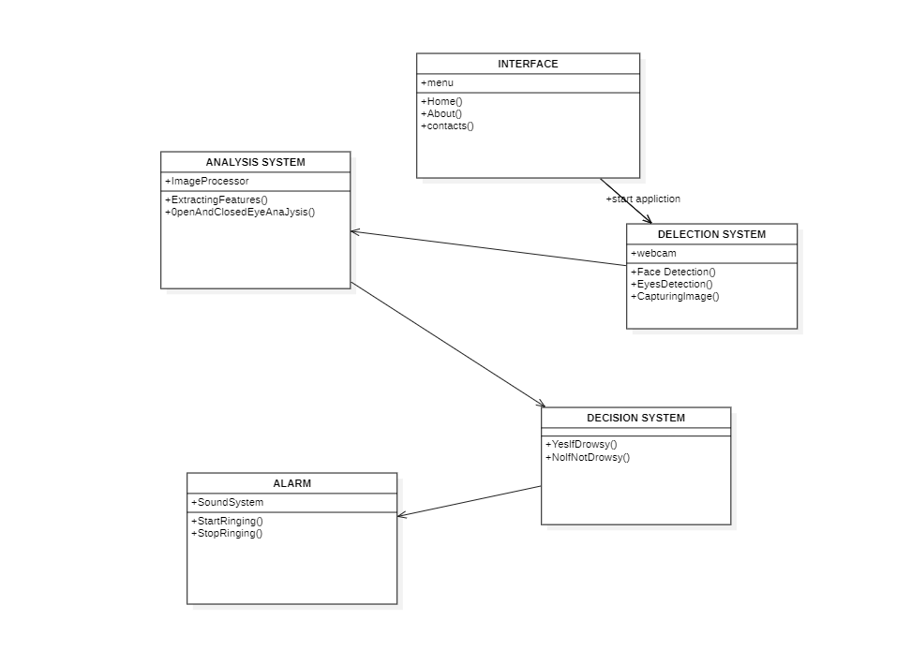

Slide 3
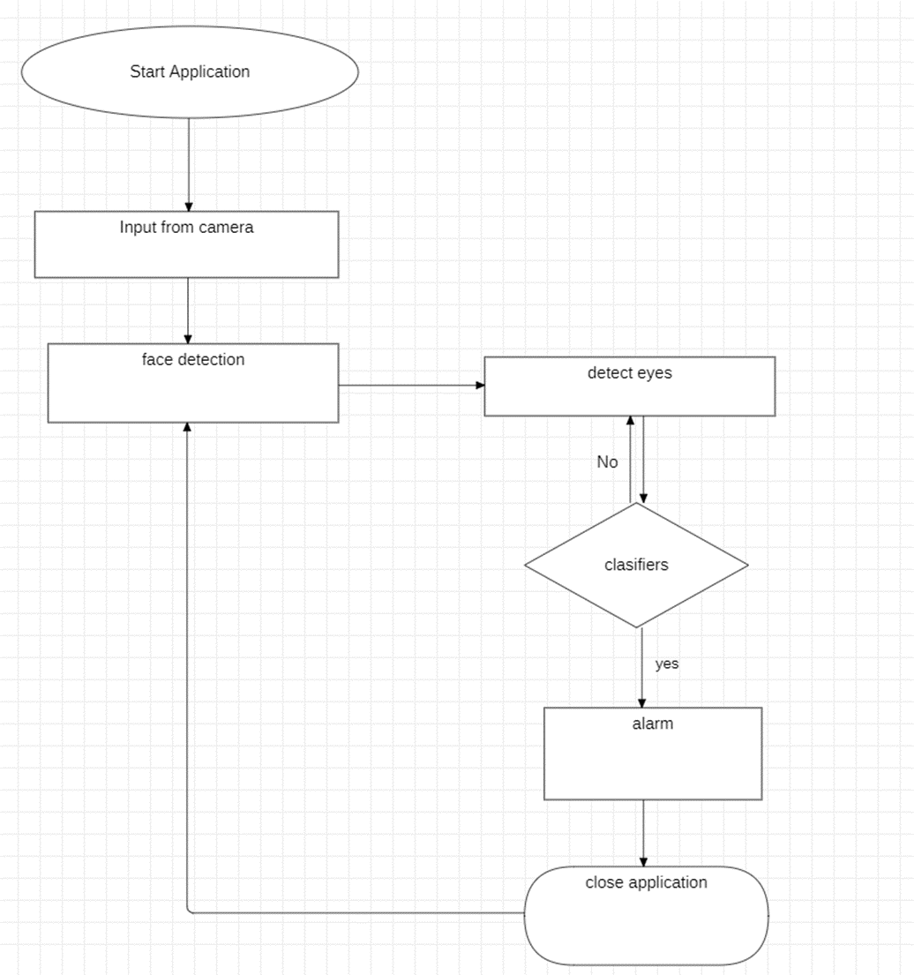
Flow chart diagram

Slide 4
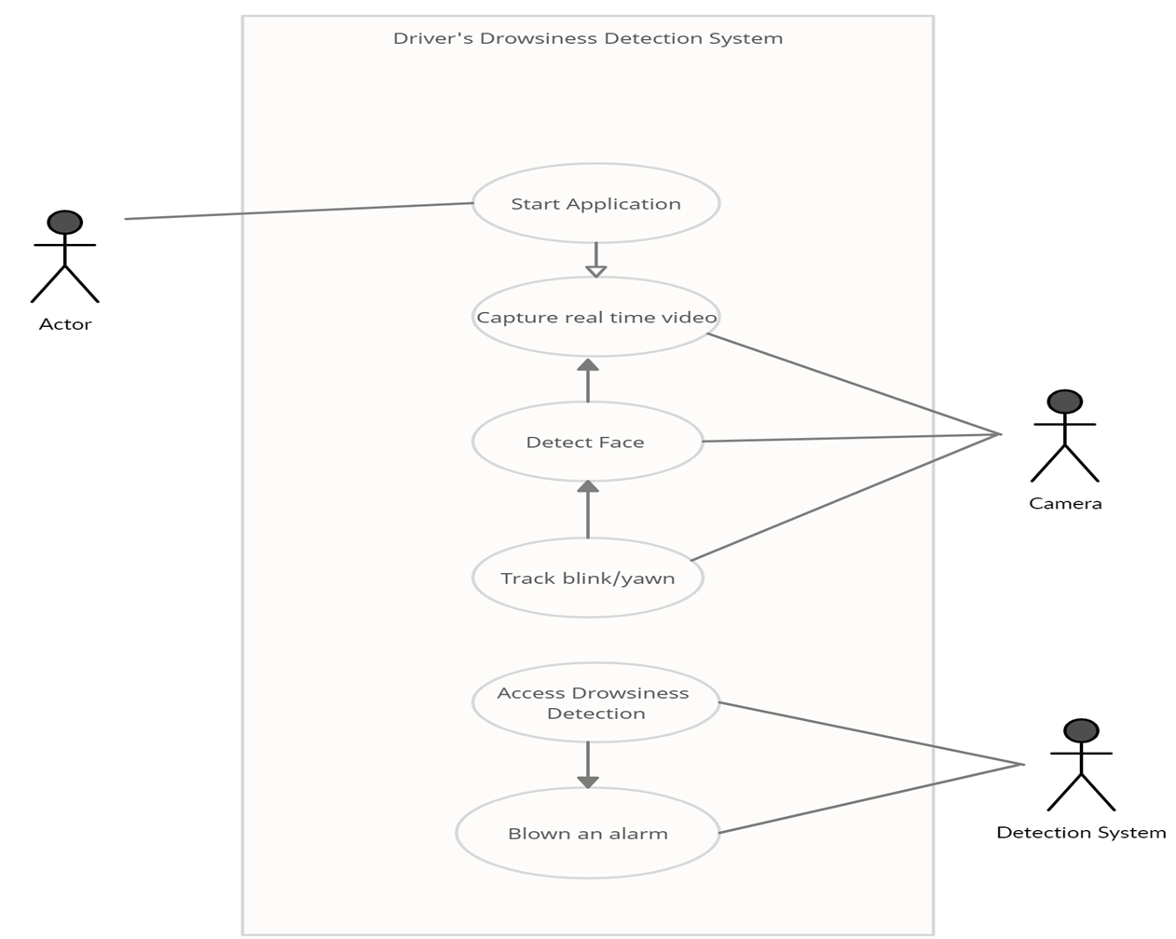
Use case

Slide 5
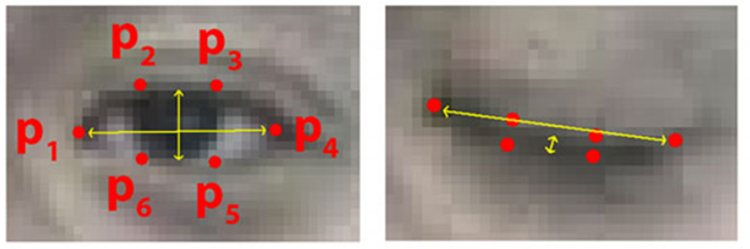
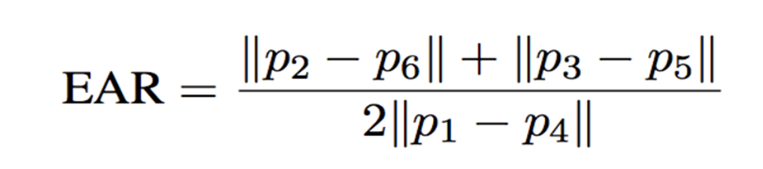
Alarm Generation
EAR = (A + B) / (2.0 * C)
EAR < = 0.2 ,Blink is detected hence alarm gets triggered.

